Slide 1


Java Se
(Core java)
Lecture-8

Slide 2
Today’s Agenda
Concept Of object and object references.
Introduction To Strings in Java
Creating String objects
Important Methods Of String Class

Slide 3
Objects and Classes
In programming any real world entity which has specific attributes or features can be represented as an Object.
Along with attributes each object can take some actions also which are called it’s “behaviors”
In programming world, these attributes are called data members and behaviours/actions are called “functions” or “methods”

Slide 4
Are you an object ?
Yes , we humans are objects because:
We have attributes as name, height, age etc.
We also can show behaviors like walking,talking,running,eating etc

Slide 5
Objects and Classes
Now to create/represent objects we first have to write all their attributes under a single group .
This group is called a class
A class is used to specify the basic structure of an object and it combines attributes and methods to be used by an object
Thus we can say that a class represents the data type and object represents a kind of variable of that data type
For Example:- Each person collectively come under a class called Human Being. So we belong to the class Human Being.

Slide 6
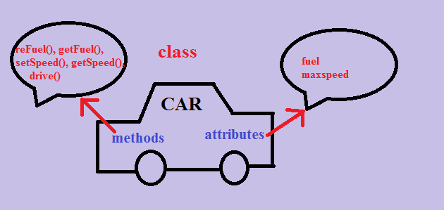
Objects and Classes

Slide 7
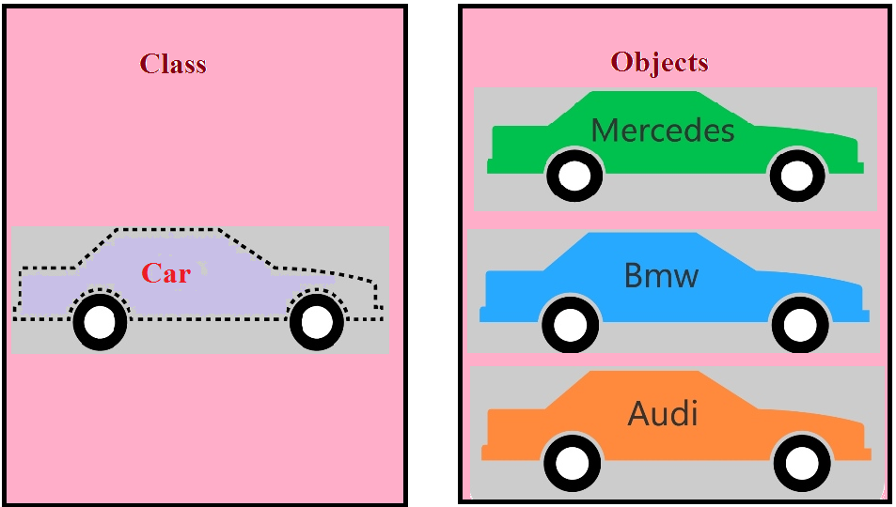
Objects and Classes

Slide 8
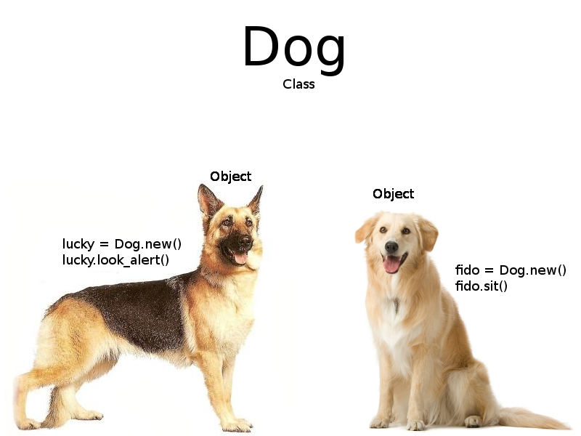
Objects and Classes

Slide 9
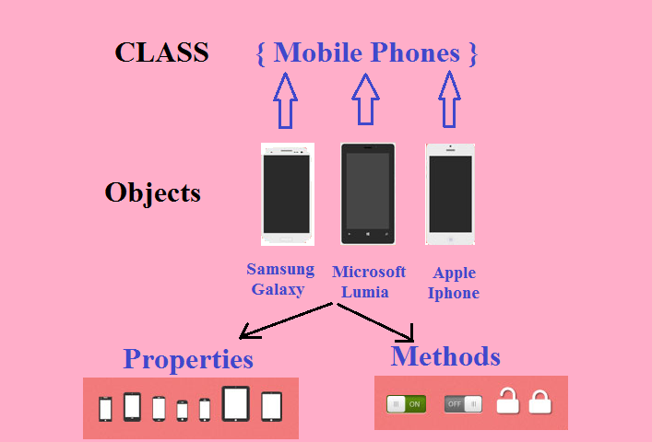
Objects and Classes

Slide 10
What Is String ?
Strings, in general are a sequence of characters.
Java platform provides String class to create and manipulate strings.
Now, since String is a class so to use it we have to create String objects
Let us see how can we create an object in Java.
But before that let us have a quick review of object creation in C++.

Slide 11
Object creation in C++
#include <iostream.h>
class Box
{
int l;
int b;
int h;
};
int main( )
{
Box B1;
Box B2;
----
return 0;
}
RAM
l
b
h
l
b
h
B1
(1000)
B2
(2000)
These are objects in c++

Slide 12
Creating Object in Java
class Box
{
int l;
int b;
int h;
}
class Test
{
public static void main(String [] args)
{
Box b;
b=new Box ();
b.l=10;
}
}
RAM
2000
l
b
h
0
0
0
2000
b
(Object Reference)

Slide 13
Creating String Object
Creating a String object is similar to that of creating any object in Java.
Step 1:- Create object reference
String s; // this is object reference
After creating object reference we have to create a String object
Step 2 :- s=new String(“BHOPAL”);
s
String object
B H O P A L
2000
2000
S
String object reference

Slide 14
Can you tell the output ?
String s1;
s1= new String(“Bhopal”);
String s2;
s2= new String(“Bhopal”);
System.out.println(s1==s2);
Guess the output for the above program???
WHY???
false
Because we are comparing references not objects and
since both references are pointing to different addresses,
the output will always be false

Slide 15
A Very Important Point!
String s1;
s1= new String(“Bhopal”);
String s2;
s2= new String(“Bhopal”);
System.out.println(s1);
System.out.println(s2);
Output:
Bhopal
Bhopal
Do you find something unusual in the output?
Yes!
Although both s1 and s2 are referenes and
they hold addresses of String objects , but when we print them
Java is not showing address stored in reference,
rather it is showing string stored in object

Slide 16
String Methods
Now since, String is a class in Java, there are methods available using which we can carry out these operations like comparing, finding string length etc…
Some of most useful methods of String class are:
length()
equals()
equalsIgnoreCase()
charAt( )

Slide 17
Using length( ) method
For calculating length of a string object, the String class gives us a method called length( ), which counts and returns number of characters the String object contains
Modified Code
String s;
s1= new String(“Bhopal”);
int x=s.length();
System.out.println( “length=“+x);
Output
length=5

Slide 18
Using equals( ) method
For comparing strings, the String class gives us a method called equals(String), which compares two strings and returns either true or false.
Modified Code
String s1;
s1= new String(“Bhopal”);
String s2;
s2= new String(“Bhopal”);
System.out.println(s1.equals(s2));
Output
true

Slide 19
Using equalsIgnoreCase( ) method
The other variant of method equals() is equalsIgnoreCase().
This method ignores the case sensitivity of the strings and compares them character wise.
Example :-
class Test
{
public static void main(String [] args)
{
String s1=new String(“MUMBAI”);
String s2=new String(“mumbai”);
System.out.println(s1.equals(s2));
System.out.println(s1.equalsIgnoreCase(s2));
}
}
Output
false
true

Slide 20
Using charAt( ) method
The charAt( ) method allows us to access the character at a particular index in the string object
To understand this , consider the following code:
String name=new String(“Sachin”);
System.out.println(name[0]);
The above code will generate syntax error because we cannot access a string object like an array i.e. subscript operator is not allowed on string object.

Slide 21
Using charAt( ) method
So , the solution to this problem is to use the method charAt( ) , whose prototype is:
public char charAt(int index)
This method accepts an index number (0 to length-1) as argument and returns the character at that index
Modified Code:
class Test
{
public static void main(String [] args)
{
String name = new String(“Sachin”);
char ch=name.charAt(0);
System.out.println(ch);
}
}
Output
S

Slide 22
Another Way Of Creating Strings
Method II :-
String s=“BHOPAL” ;
* Thus unofficially we can say that the following 2 ways are almost same:
String s= new String(“BHOPAL”) ;
OR
String s=“BHOPAL” ;
B H O P A L
2000
2000
s
However there is a very very important difference between them technically, that we will discuss in String Handling chapter.

Slide 23
Concatenating Strings
Concatenating two String objects is similar to what we learnt earlier.
It can be done simply through the operator “+” .
Example :-
class Test
{
public static void main(String [] args)
{
String s1=new String(“Bhopal”);
String s2=new String(“Chopal”);
System.out.println(s1+s2);
}

Slide 24

End Of Lecture 8
For any queries mail us @: scalive4u@gmail.com
Call us @ : 0755-4271659, 9826086245
Agenda for Next Lecture:
Control Statements
Syntax Of “if”,”if-else”,”if-else if-else”
The “switch” Keyword
Ternary Operator

